Slide 1
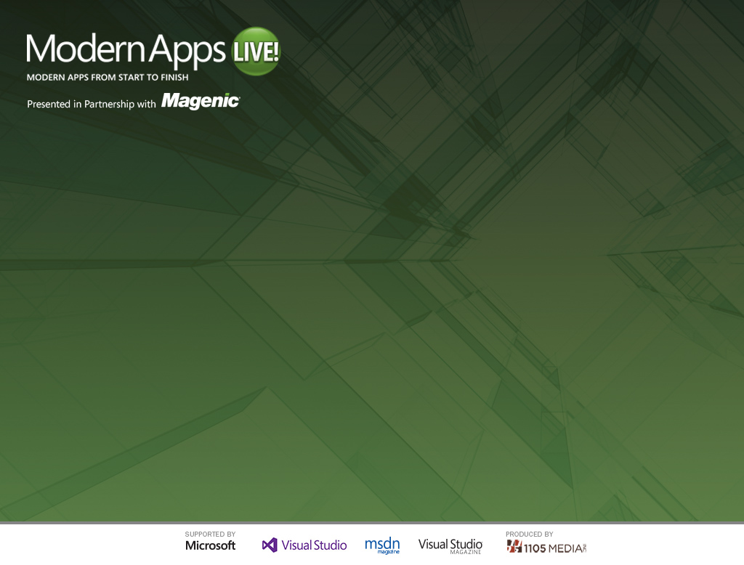
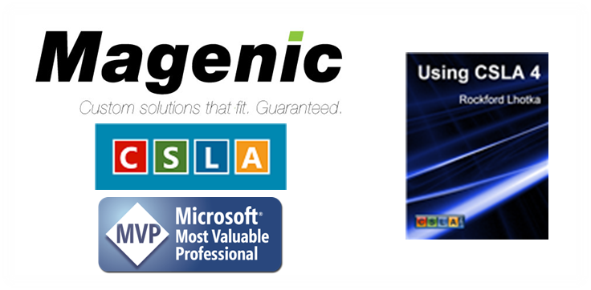
Application Server, Windows Server, and Windows Azure
Rockford Lhotka
CTO at Magenic
Level: Intermediate

Slide 2
MyVote Application Server
iOS UI
WinPRT UI
WinRT UI
Reports
Excel
iOS BL
BL
BL
SQL Reporting
PowerPivot
Service Proxy
Data Portal
Data Portal
REST API
ASP.NET WA
Data Portal
BL
DAL
SQL Database
Blobs

Slide 3



Cloud Computing Models
SOFTWARE
as a SERVICE
PLATFORM
as a SERVICE
INFRASTRUCTURE
as a SERVICE

Slide 4
Azure Overview
Web Sites
Build with ASP.NET, PHP or Node.js
Mobile Services
Turnkey backend solutions for your mobile app.
Big Data
Fully compatible enterprise-ready Hadoop service.
Deploy in seconds with FTP, Git or TFS
Incorporate storage, user authentication & push notifications
Integrates with Active Directory and System Center
Virtual Machines
Deploy Windows and Linux VM’s.
Cloud Services
Enterprise-grade cloud platform PaaS environment.
Media
Create, manage and distribute media in the cloud
provides encoding, protection, streaming & analytics support
Migrate existing applications & infrastructure.
multi-tier scenarios, automated deployments & elastic scale.

Slide 5





Challenges in the Enterprise
Long setup and cycle times
High infrastructure costs
Limited data center capacity
Hard to replicate production
Azure Offers
Azure VMs to run dev and test workloads.
Solution
Test Teams
Dev Teams
Seamless connectivity with on-premises data & apps
Azure Connect VPN
Saved VM State
On Premises
Easier access for geographically dispersed teams
Azure storage
Apps
Data
Test/Dev VMs

Slide 6
Build, Test, Deploy to Production from Azure
Build
Test
Deploy
VS 2010
TFS Online
Azure SDK
TFS Build
Deploy to Azure
Notes:
Demo : http://www.windowsazure.com/en-us/develop/net/common-tasks/publishing-with-tfs/

Slide 7
Dual API
.NET clients
CSLA .NET data portal
Focus on productivity, simplicity, fast development
iPad client
Web API REST services
Focus on openness, interoperability

Slide 8
Application Server Demo

Slide 9
Thank you!
Rockford Lhotka
rockyl@magenic.com

